Slide 1
IT trends and Computing disciplines
Assoc. Prof. Huynh Trung Hieu

Slide 2
Contents
Disciplines of Computing
Technology Trends
Human Resources
Work areas and Typical Jobs

Slide 3
The Disciplines of Computing
Association for Computing Machinery (ACM)
Computer Science
Computer Engineering
Information Systems
Information Technology
Software Engineering

Slide 4
The Landscape of Computing Disciplines
Undergraduate degree programs in the computing-related disciplines began to emerge in the 1960s
Before the 1990s
computer science,
electrical engineering,
information systems
EE
CS
IS
Hardware
Software
Business

Slide 5
Before the 1990s
For students who wanted to become expert in developing software or with the theoretical aspects of computing, computer science was the obvious choice.
For students who wanted to work with hardware, electrical engineering was the clear option.
For students who wanted to use hardware and software to solve business problems, information systems was the right choice.
EE
CS
IS
Hardware
Software
Business

Slide 6
Before the 1990s
With the advent of the microprocessor in the mid-1970s, computer engineering began to emerge from within electrical engineering to become a discipline into itself.
EE
CE

Slide 7
Significant Developments of the 1990s
Computer chips became basic components of most kinds of electrical devices and many kinds of mechanical devices. Computer engineers design and program the chips that permit digital control of many kinds of devices.
Computer science grew rapidly and became accepted into the family of academic disciplines. Industry needs for qualified computer science graduates exceeded supply by a large factor.

Slide 8
Significant Developments of the 1990s
Software engineering had emerged as an area within computer science. As computing is used to attack a wider range of complex problems, creating reliable software becomes more difficult. Over time, it became clear that producing good software is very difficult, very expensive, and very necessary. This lead to the creation of software engineering.

Slide 9
Significant Developments of the 1990s
Information systems had to address a growing sphere of challenges. By the end of 1990s, networks are developed=>computers were no longer tools only for technical specialists; they became integral parts of the work environment used by people at all levels of the organization
Because of the expanded role of computers, organizations had more information available than ever before and organizational processes were increasingly enabled by computing technology. The problems of managing information became extremely complex, and the challenges of making proper use of information and technology to support organizational efficiency and effectiveness became crucial issues.

Slide 10
Significant Developments of the 1990s
Information technology programs began to emerge in the late 1990s. During the 1990s, computers became essential work tools at every level of most organizations, and networked computer systems became the information backbone of organizations.
IT departments within corporations and other organizations took on the new job of ensuring that the organization’s computing infrastructure was suitable, that it worked reliably, and that people in the organization had their computing-related needs met, problems solved, etc.

Slide 11
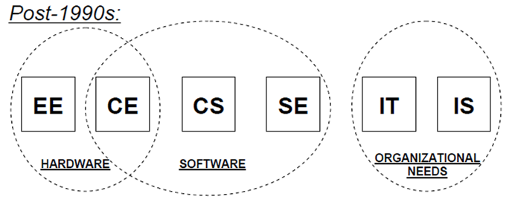
After the 1990s
Software:
CE: software attention is focused on hardware devices.
SE: The emphasis is on creating software that satisfies robust real-world requirements.
CS: Ideas are expressed and a wide range of computing problems and applications are explored.

Slide 12
After the 1990s
Organizational needs:
IT: use technology as critical instruments for addressing organizational needs. It focuses on ensuring that the organization’s infrastructure is appropriate and reliable.
IS: focuses on the generation and use of information.

Slide 13
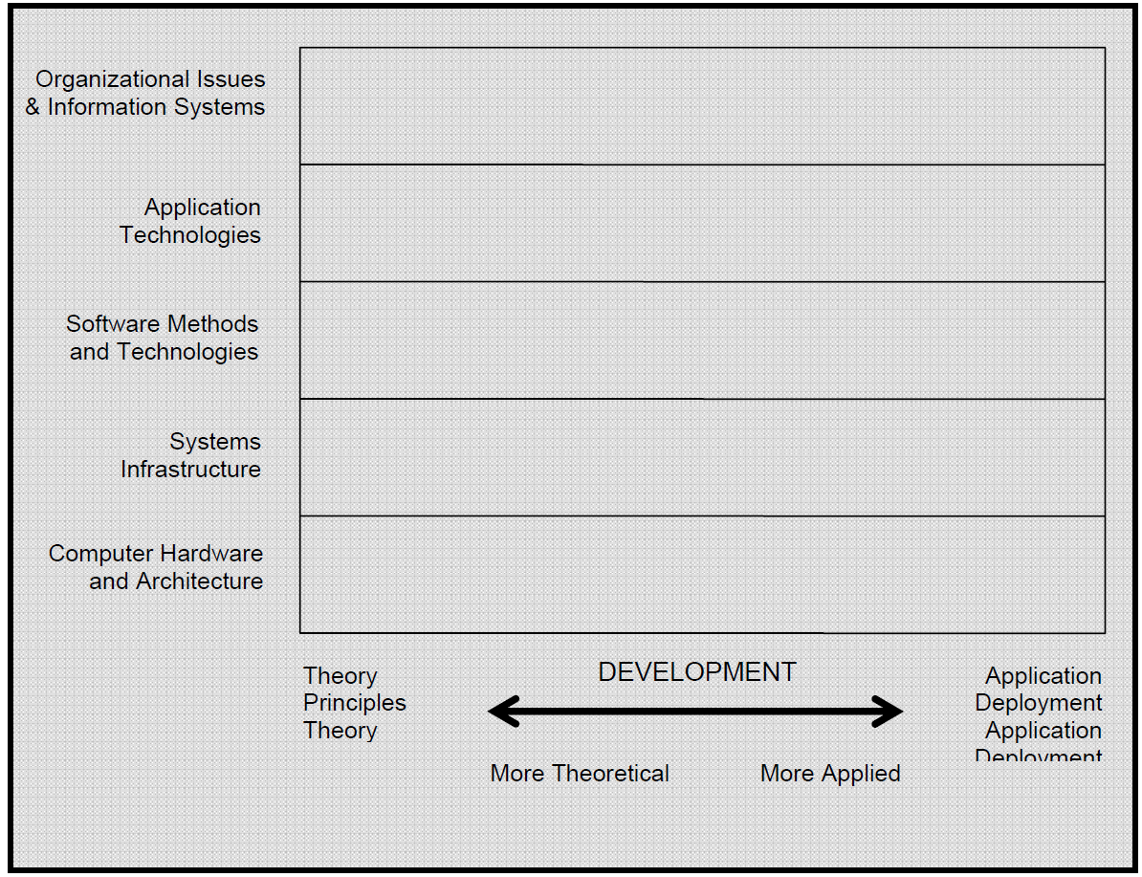
The Major Computing Disciplines
Source: ACM

Slide 14
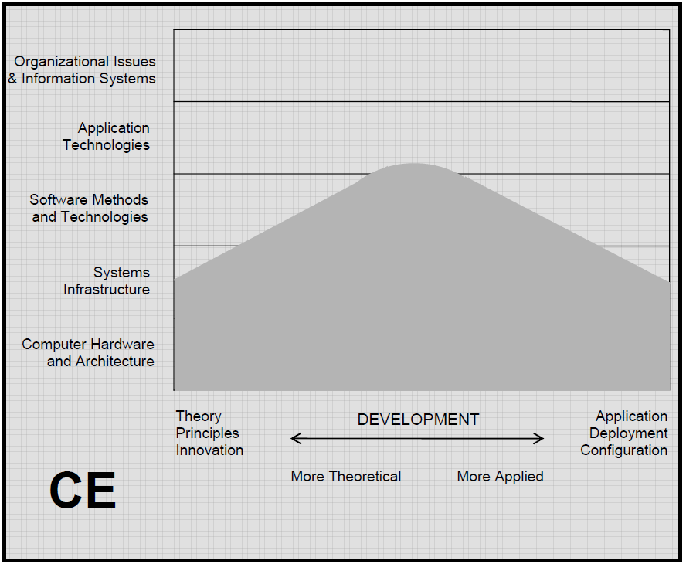
The Major Computing Disciplines
Source: ACM

Slide 15
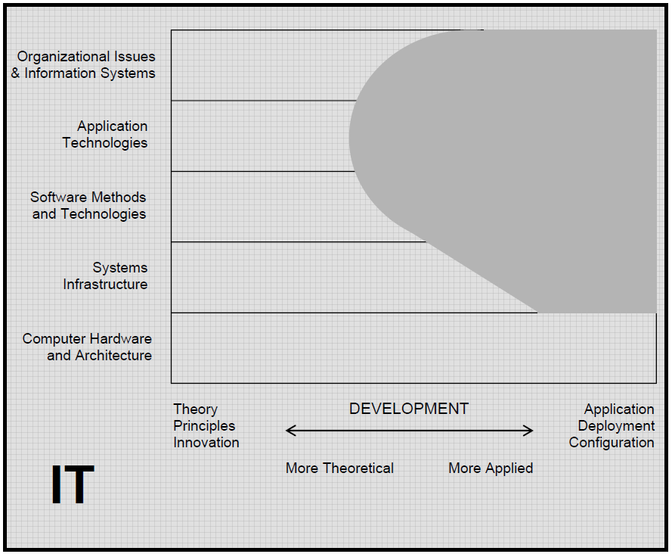
The Major Computing Disciplines
Source: ACM

Slide 16
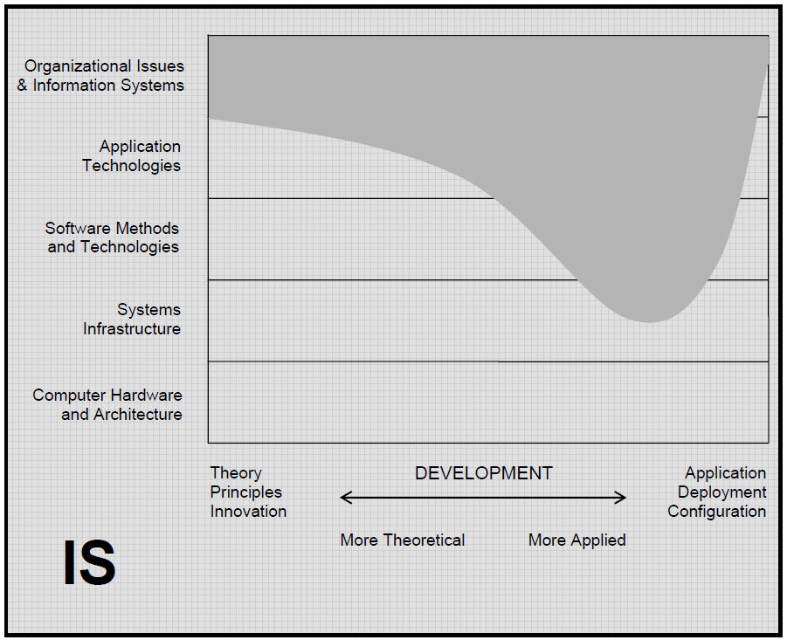
The Major Computing Disciplines
Source: ACM

Slide 17
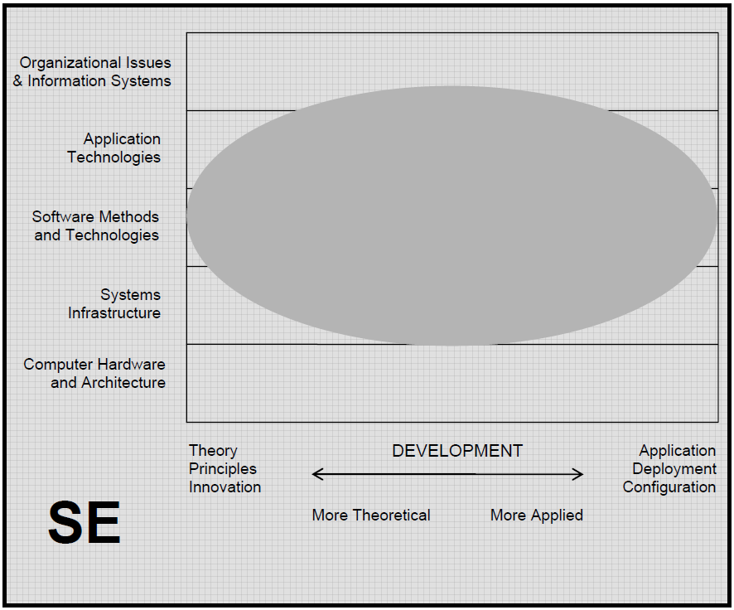
The Major Computing Disciplines
Source: ACM

Slide 18
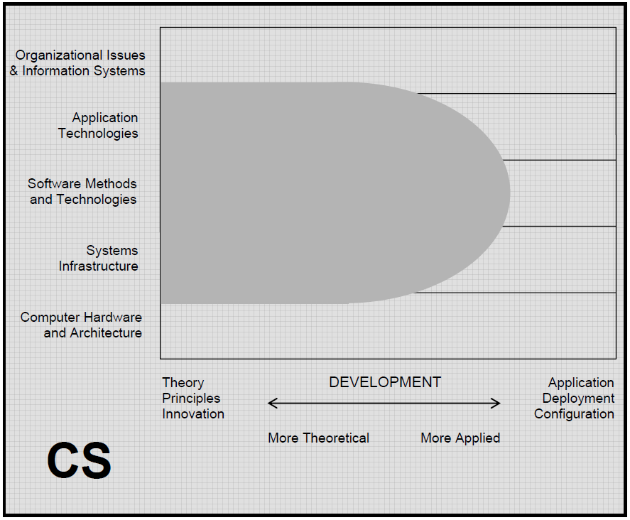
The Major Computing Disciplines
Source: ACM

Slide 19
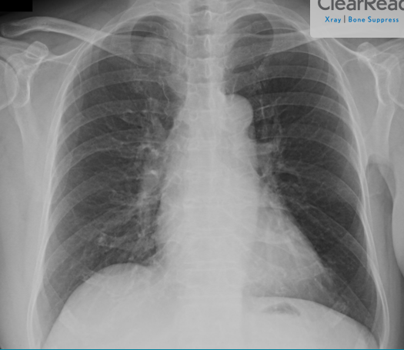
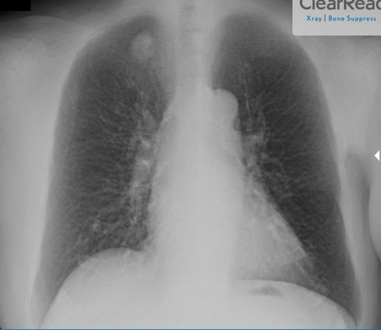
The Major Computing Disciplines

Slide 20
Contents
Disciplines of Computing
Technology Trends
Human Resources
Work areas and Typical Jobs

Slide 21

Technology trends
Digital mesh
Smart machines
The New IT reality
Mobile Cloud Big data Social
Mobile devices
Millions of Apps
Billions of users
3rd Platform
Hundreds of Millions of users
2nd Platform
LAN/internet, Client/Server
PC
Tens of Thousands of Apps
1st Platform
Mainframe, Minicomputer, Terminal
Millions of users
Thousands of Apps

Slide 22
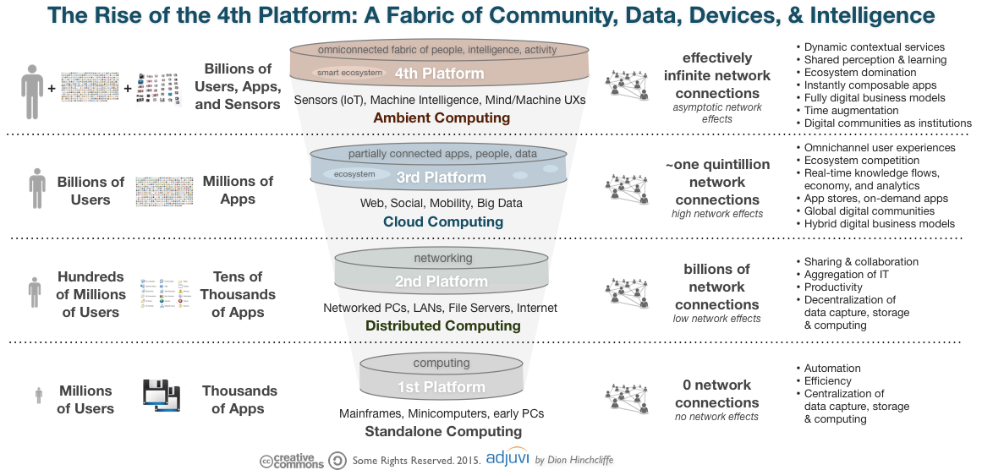
Technology trends

Slide 23
Technology trends
Smart Machines
Information of every things
Advanced machine learning
Autonomous agents and things
Digital Mesh
Device mesh
Ambient user experience
3D printing materials
Adaptive security arch.
Advanced system arch.
Mesh app and service arch.
IoT architecture and platforms
New IT Reality

Slide 24
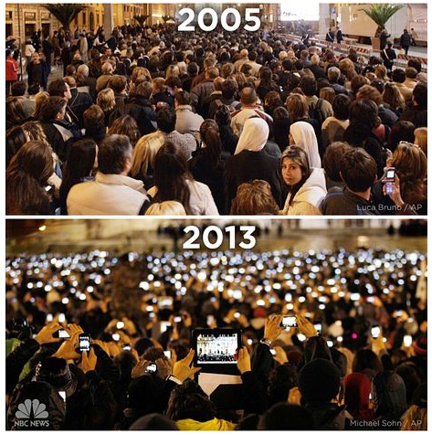
Digital Mesh
Device Mesh

Slide 25
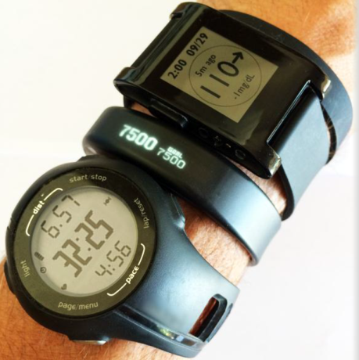
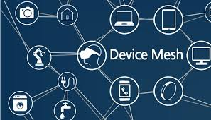
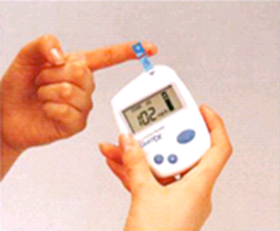
Digital Mesh
Notes:
Including mobile devices, wearable, consumer and home electronic devices, automotive devices and environmental devices — such as sensors in the Internet of Things (IoT).
A variety of other trends have led to an increased number of sensors embedded in many technologies and devices that we use personally and professionally. They become smarter as they gather more data on our daily patterns.

Slide 26
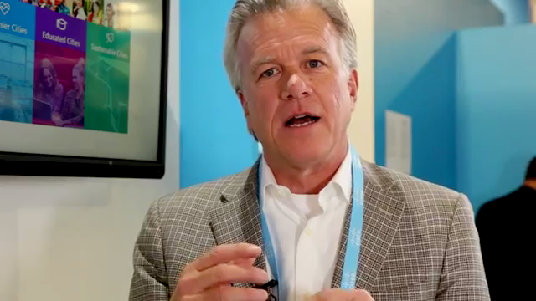
Digital Mesh
User ambient experience
The experience blends physical, virtual and electronic environments, gather more contextual data.
Organizations will need to consider their customers’ behavior journeys to shift the focus on design from discrete apps to the entire mesh of products and services involved in the user experience.
Notes:
All of our digital interactions can become synchronized into a continuous and ambient digital experience that preserves our experience across traditional boundaries of devices, time and space. The experience blends physical, virtual and electronic environments, and uses real-time contextual information as the ambient environment changes or as the user moves from one place to another.

Slide 27
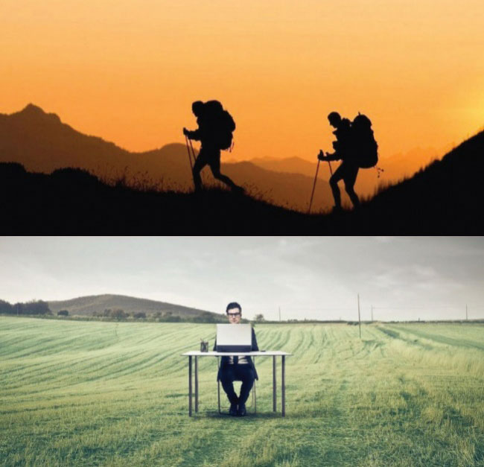
Digital Mesh
User ambient experience

Slide 28
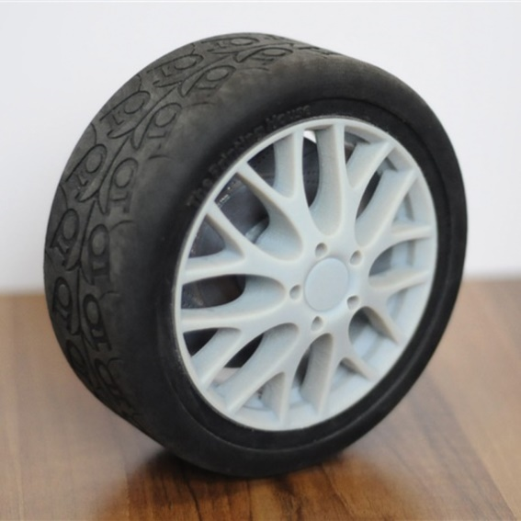
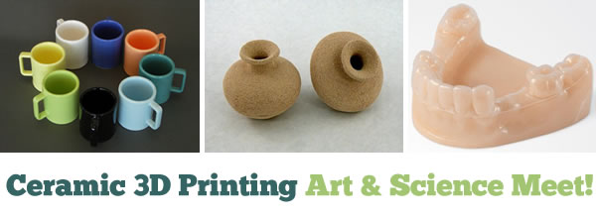
Digital Mesh
3D printing materials

Slide 29
Technology trends
Smart Machines
Information of every things
Advanced machine learning
Autonomous agents and things
Digital Mesh
Device mesh
Ambient user experience
3D printing materials
Adaptive security arch.
Advanced system arch.
Mesh app and service arch.
IoT architecture and platforms
New IT Reality

Slide 30
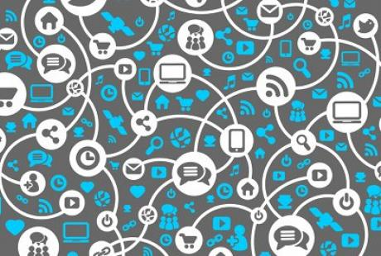
Smart machines
Information of everything
Notes:
IoT: Information of everything addresses this influx with strategies and technologies to link data from all these different data sources. Information has always existed everywhere but has often been isolated, incomplete, unavailable or unintelligible. Advances in semantic tools such as graph databases as well as other emerging data classification and information analysis techniques will bring meaning to the often chaotic deluge of information. Organizations must learn how to identify what information provides strategic value, how to access data from different sources, and explore how algorithms leverage Information of Everything to fuel new business designs.

Slide 31
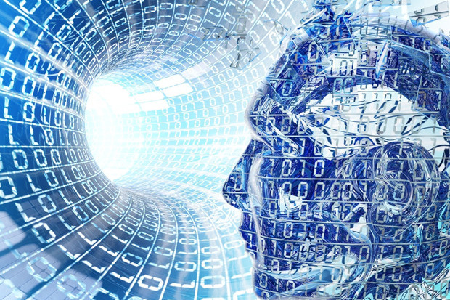
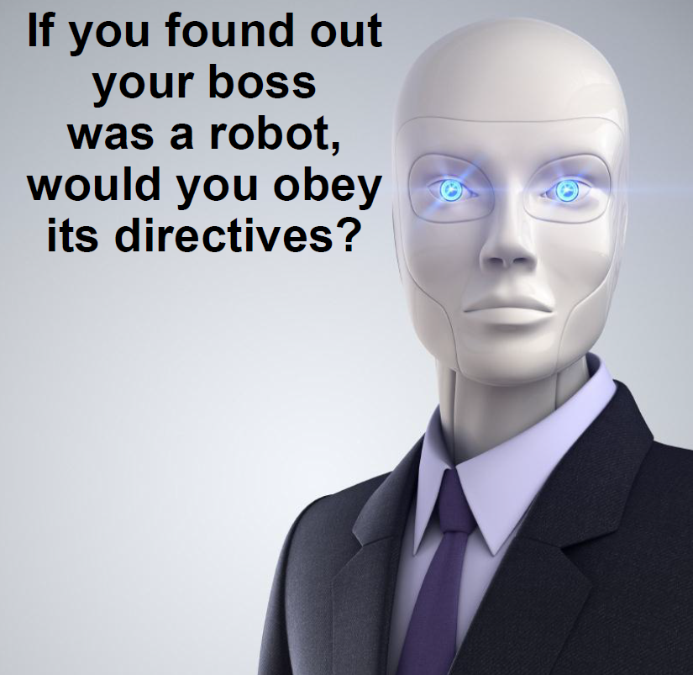
Smart machines
By 2018, more than 3 million workers globally will be supervised by a "roboboss“. 20% of all business content will be authored by machines
Advanced Machine Learning
Notes:
Advanced machine learning is what makes smart machines appear “intelligent” by enabling them to both understand concepts in the environment, and also to learn. Through machine learning a smart machine can change its future behavior. This area is evolving quickly, and organizations must assess how they can apply these technologies to gain competitive advantage.

Slide 32

Smart machines
Autonomous Agents and Things
Notes:
Autonomous Agents and Things: Machine learning gives rise to a spectrum of smart machine implementations — including robots, autonomous vehicles, virtual personal assistants (VPAs) and smart advisors — that act in an autonomous (or at least semiautonomous) manner

Slide 33
Technology trends
Smart Machines
Information of every things
Advanced machine learning
Autonomous agents and things
Digital Mesh
Device mesh
Ambient user experience
3D printing materials
Adaptive security arch.
Advanced system arch.
Mesh app and service arch.
IoT architecture and platforms
New IT Reality

Slide 34

New IT Reality
The complexities of digital business and the algorithmic economy, combined with an emerging “hacker industry,” significantly increase the threat surface for an organization. IT leaders must focus on detecting and responding to threats, as well as more traditional blocking and other measures to prevent attacks.

Slide 35
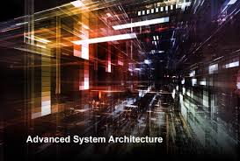
New IT Reality
Notes:
The digital mesh and smart machines require intense computing architecture demands to make them viable for organizations.
"Systems built on GPUs and FPGAs will function more like human brains that are particularly suited to be applied to deep learning and other pattern-matching algorithms that smart machines use," said Mr. Cearley.

Slide 36
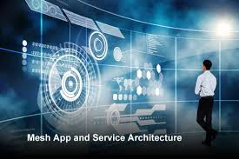
New IT Reality
Notes:
The mesh app and service architecture are what enable delivery of apps and services to the flexible and dynamic environment of the digital mesh. This architecture will serve users’ requirements as they vary over time. It brings together the many information sources, devices, apps, services and microservices into a flexible architecture in which apps extend across multiple endpoint devices and can coordinate with one another to produce a continuous digital experience.

Slide 37
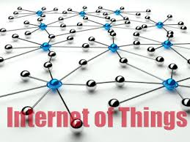
New IT Reality
By 2020, 20.8 billion connected things will be in use. The Internet of Things (IoT) will support total services spending of $235 billion in 2016
Notes:
IoT platforms exist behind the mesh app and service architecture. The technologies and standards in the IoT platform form a base set of capabilities for communicating, controlling, managing and securing endpoints in the IoT. The platforms aggregate data from endpoints behind the scenes from an architectural and a technology standpoint to make the IoT a reality.

Slide 38
Technology trends

Slide 39
Human resources
Y2020: Shortage of IT HR: 400,000
30,000
IT
25,000
Biotech.
QTSC
3,000/Year
25,000
Automation tech.
25,000
Materials tech.
SHTP, HCMC (2020)

Slide 40
Work areas
Application development
Embedded system
Mobile Application
E-Commerce/Web
Production/Automation
Quality Assurance/Testing
ERP/CRM/SCM
Circuit/Board Design
Banking/Finance
Media/Multimedia
Graphics Design
S.M.A.C/R&D
Information Security
Network/System
Telecommunication
Hardware/Support
…..

Slide 41
Typical IT Jobs
SW/Game Programmer
Software Designer
Software Tester
Quality/Process Engineer
System/Business Analyst
Project Manager/Manager
Database Engineer
ERP/MIS Engineer
Circuit Designer
Security Manager
Network Administrator
IT Manager
Hardware Engineer
Multimedia/Media engineer
Consultant/Expert
IT Supporter
Freelancer
…

Slide 42
Industry 4.0 and the fourth industrial revolution (4IR)
The first industrial revolution
which REALLY was a revolution, and, among others thanks to invention of steam machines, the usage of water and steam power and all sorts of other machines, would lead to the industrial transformation of society with trains, mechanization of manufacturing and loads of smog.
The second industrial revolution
is typically seen as the period where electricity and new manufacturing ‘inventions’ which it enabled, such as the assembly line, led to the area of mass production and to some extent to automation.

Slide 43
Industry 4.0 and the fourth industrial revolution (4IR)
The third industrial revolution
had everything to do with the rise of computers, computer networks (WAN, LAN, MAN,…), the rise of robotics in manufacturing, connectivity and obviously the birth of the Internet, that big game changer in the ways information is handled and shared, and the evolutions to e-anything versions of previously brick and mortar environments only, with far more automation.
The fourth industrial revolution
we move from ‘just’ the Internet and the client-server model to ubiquitous mobility, the bridging of digital and physical environments (in manufacturing referred to as Cyber Physical Systems), the convergence of IT and OT (operational technology), and all the previously mentioned technologies (Internet of Things, Big Data, cloud, etc.) with additional accelerators such as advanced robotics and AI/cognitive which enable Industry 4.0 with automation and optimization in entirely new ways that lead to ample opportunities to innovate and truly fully automate and bring the industry to the next level

Slide 44
